Slide 1
Mini Project 1
UNICODE
Name of the Sudent | Roll No | Batch No
P.Kiran | 19H51A05P6 | B94
P.Sathvika | 19H51A05P5
S.Rahul | 19H51A05L9
Name of the Guide | Mrs.B.Sowjanya

Slide 2
TABLE OF CONTENTS
Abstract
Problem statement
Introduction
Literature Review
Motivation
Objectives
Proposed solutions
Software requirements
Future scope
conclusion

Slide 3

Abstract
We are trying to build a platform for the college students where they can allow pen testers to test and report the vulnerabilities present in their applications.
This will help both students and testers to gain the knowledge.

Slide 4
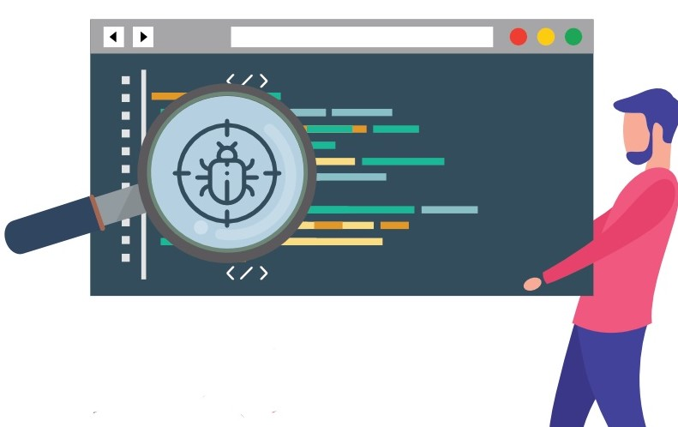
Problem Statement
Design an application that helps students to solve their bugs
Problem Statement
Design an application that helps students to solve their bugs
Design an application that helps students to solve their bugs

Slide 5
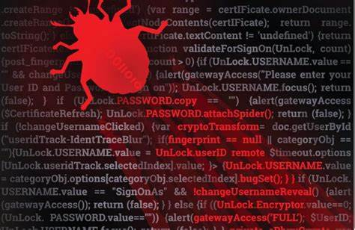
INTRODUCTION
This project Unicode is a web application that is used to discover and resolve bugs before the general people are aware of it.

Slide 6
LITERATURE REVIEW
https://www.researchgate.net/publication/333098279_Bug_Bounty_Programs_for_Cybersecurity_Practices_Issues_and_Recommendationsbug bounty.pptx
https://www.hackerone.com

Slide 7

EXISTING SOLUTIONS
HACKER ONE
HackerOne was started by hackers and security leaders who are driven by a passion to make the internet safer. Our platform is the industry standard for hacker-powered security. We partner with the global hacker community to surface the most relevant security issues of our customers before they can be exploited by criminals
Link : https://www.hackerone.com

Slide 8

ANALYSIS
.
Console design
testing
implementation
Requirements
datasheet
testing
implementation
Source code
testing
implementation

Slide 9
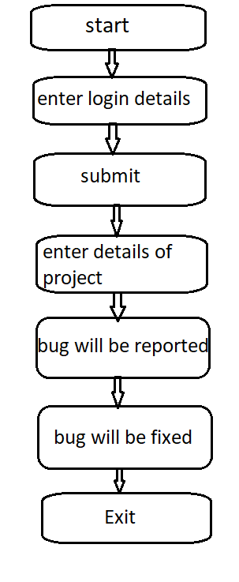
Activity diagram
.

Slide 10
MOTIVATION
The main moto to select this project is most of the students are doing there projects but they are not aware of the vulnerabilities of it.

Slide 11
OBJECTIVES
Dynamic model
It is helpful for the students

Slide 12

PROPOSED SOLUTIONS
We have developed a web application called “Unicode” which is useful for students to post their website and web application details, so that developers will fix their bugs.

Slide 13
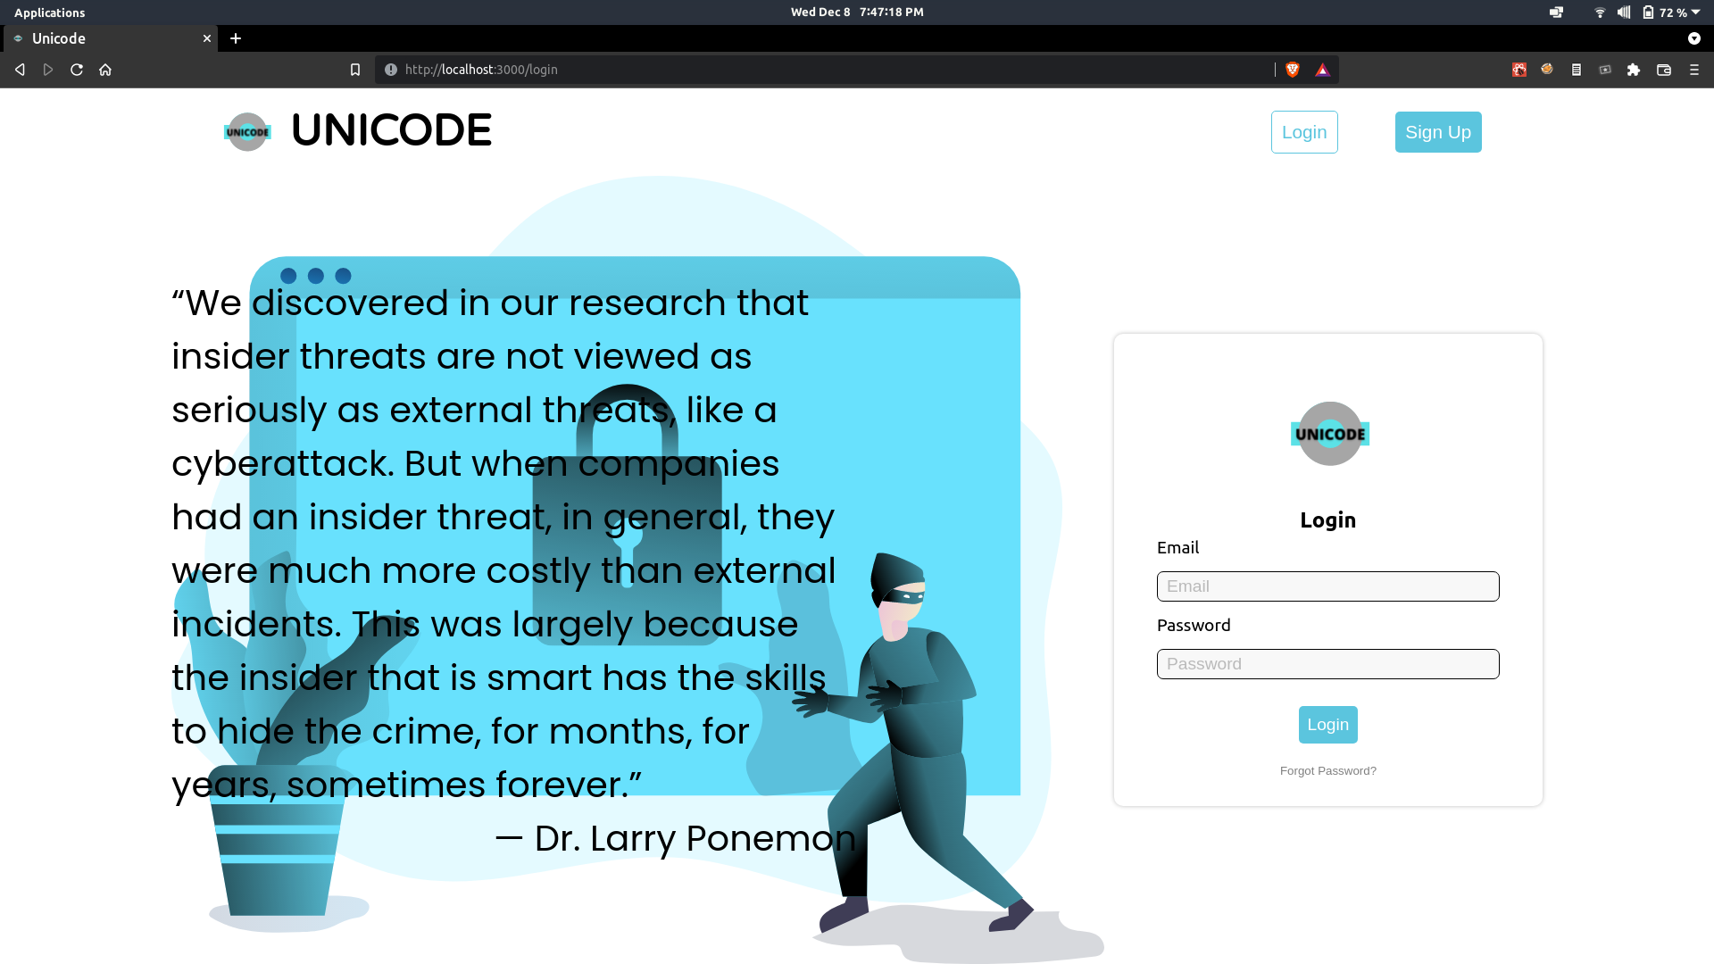
UNICODE
.

Slide 14
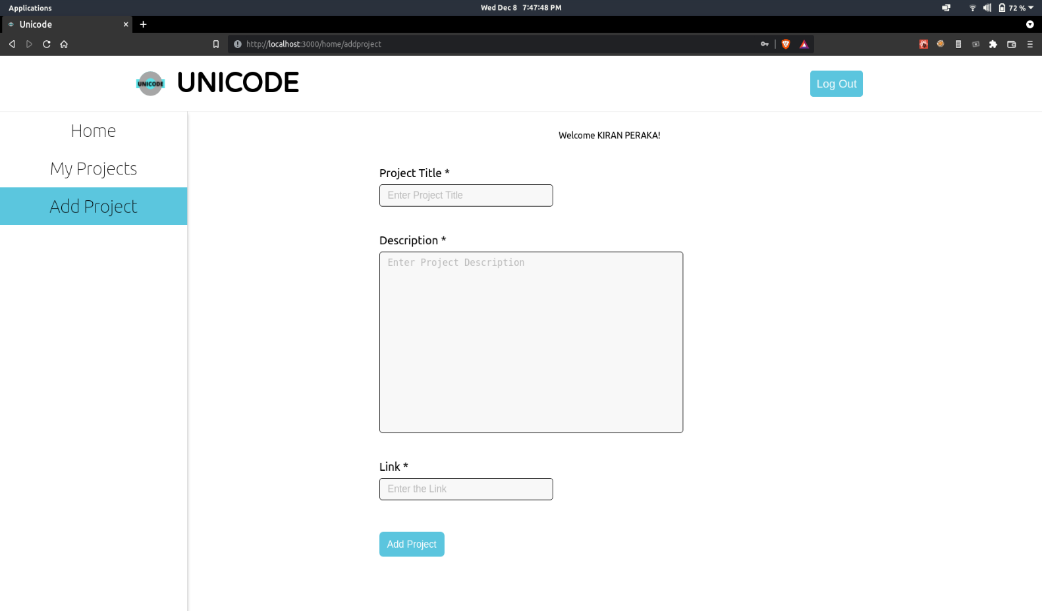
IMPLEMENTATION

Slide 15
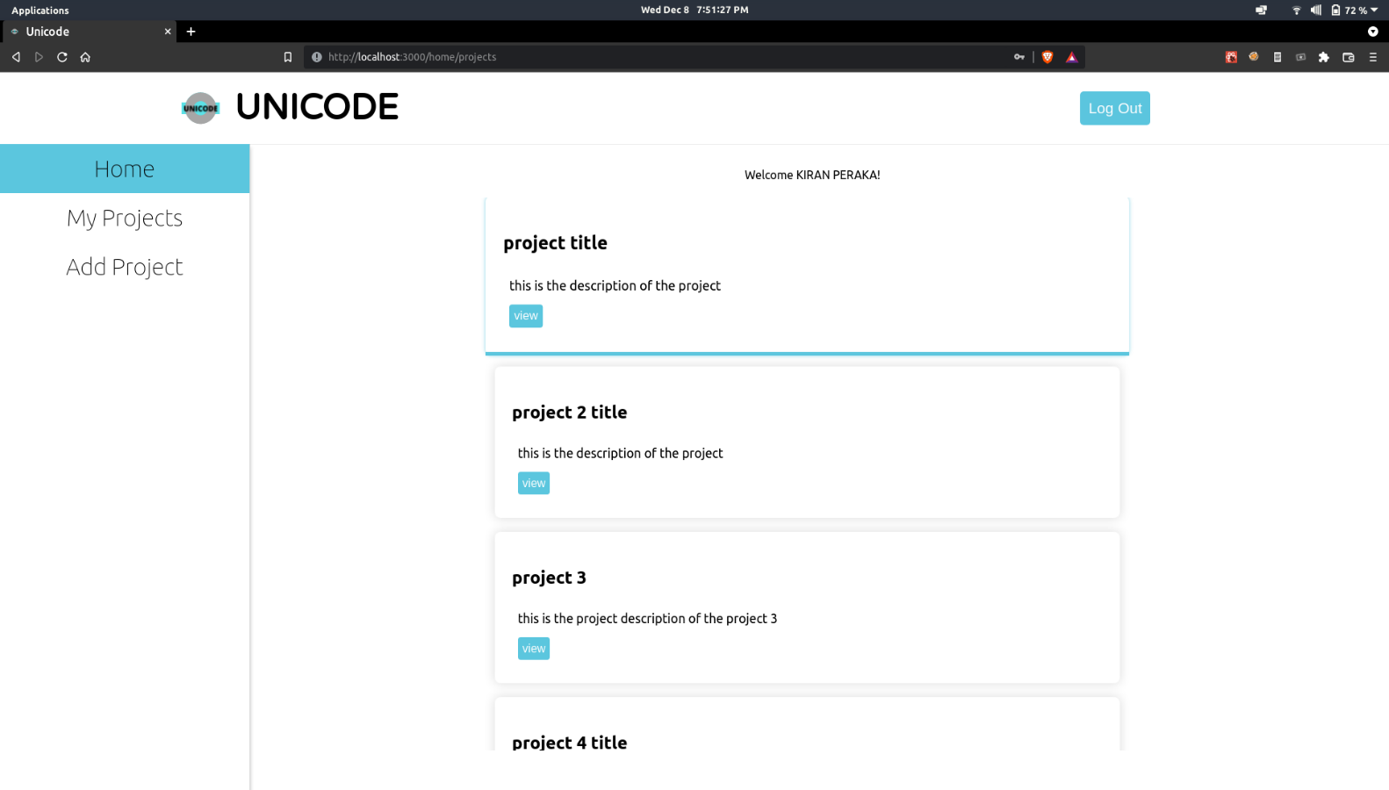
IMPLEMENTATION

Slide 16
Software REQURIMENTS
HTML
CSS
REACT JS
EXPRESS JS
MONGO DATABASE

Slide 17

FUTURE SCOPE
As this project is developed only within the scope of college community, it will enable students to resolve their bugs and also to gain knowledge.

Slide 18
CONCLUSION
This application helps developers to secure their applications and it will also help students in fixing their bugs learning from it.

Slide 19

.

